Slide 1

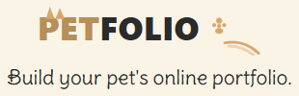
The Institute of Wizards

Slide 2
INTRODUCTION
Petfolio is a social media platform where users can post photos of their pets, write captions and interact with other users posts through comments.
User Story: As a user, I want to share images and descriptions of my pets, so that my friends can view and comment on my posts.
Team Roles:
Fraser Elliott: Team Leader
Dylan Rhodes: Backend Developer
Beatrice Emakpose: Frontend Developer
Charles Richer: Frontend Developer
Sherene Edwards: Assistance with data
Technologies Used:
Frontend: HTML, CSS, JavaScript, React
Backend: Node.js, Express.js
Database: MySQL, Sequelize ORM
Image Hosting: Multer & Cloudinary
Tools & Environment: GitHub, Postman, npm

Slide 3
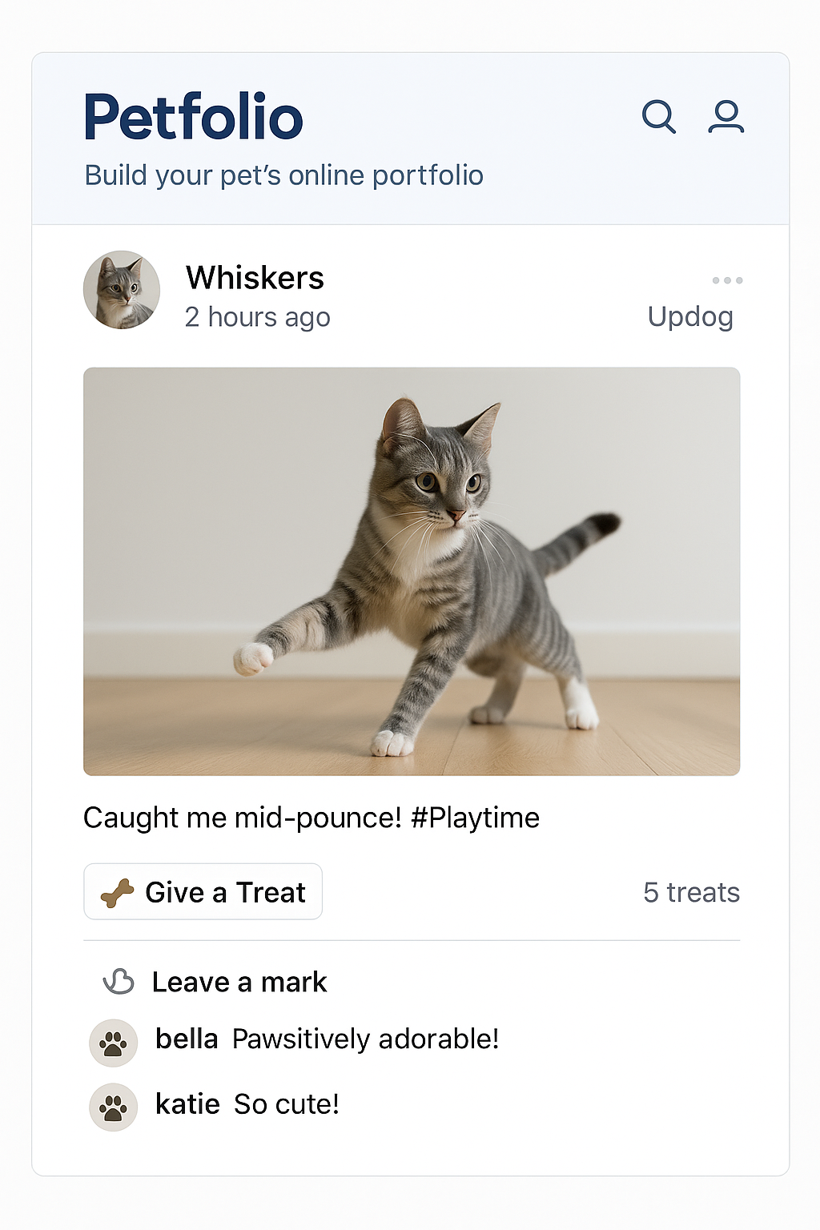
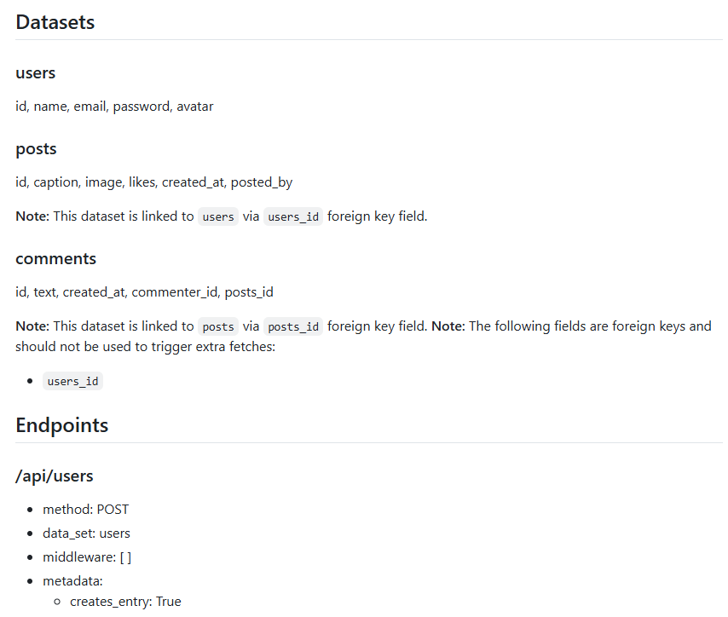
DEVELOPMENT PROCESS
We started with a full stack template Fraser made that includes a mock server and mock data generation with Python, README generation with notes on mock server endpoints, and scripts to run vite with an API URL set to either target the mock server or the real backend. We made a concept image for how the website may look.

Slide 4
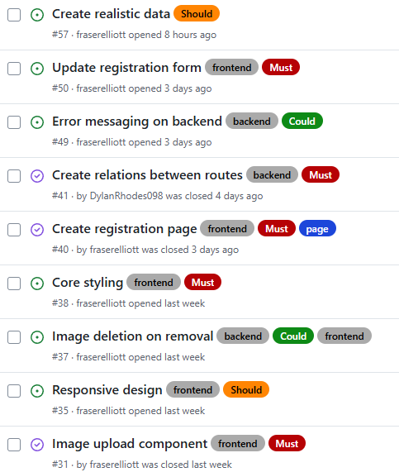
DEVELOPMENT PROCESS
We agreed on a direction for the project and broke all features down into must haves, could haves, and should haves. We worked out the structure of data and API endpoints we'd need to achieve this. An issue board was then made with the features discussed to give clear goals for the MVP and post-MVP improvements.

Slide 5
PRODUCT FEATURES
User Accounts & Profiles
Sign up with a profile picture / log in
Post Creation
Upload pet photos
Add captions
Option to edit or delete posts
Post Feeds
Home page feed to show all posts
Following page
Engagement Features
View and add comments
Like posts
Community Interaction
View other users’ profiles
Follow/unfollow users

Slide 6
FRASER ELLIOTT
Role: Team Leader
Responsibilities:
  Creating and managing issue board
  Reviewing pull requests
  Working on issues where required
Features added:
  Contexts - frontend
  Following users - frontend and backend
  Image upload - frontend and backend
Challenges
  Balancing time between working on issues, reviewing pull requests and helping team with code
Achievements
  The issue board really helped us achieve a clear goal with everyone able to choose what to work on

Slide 7
DYLAN RHODES
Role: Backend Developer
Technologies used:
Backend: Node.js, Express.js
Database: MySQL, Sequelize ORM
Tools & Environment: GitHub, Postman, npm

Slide 8
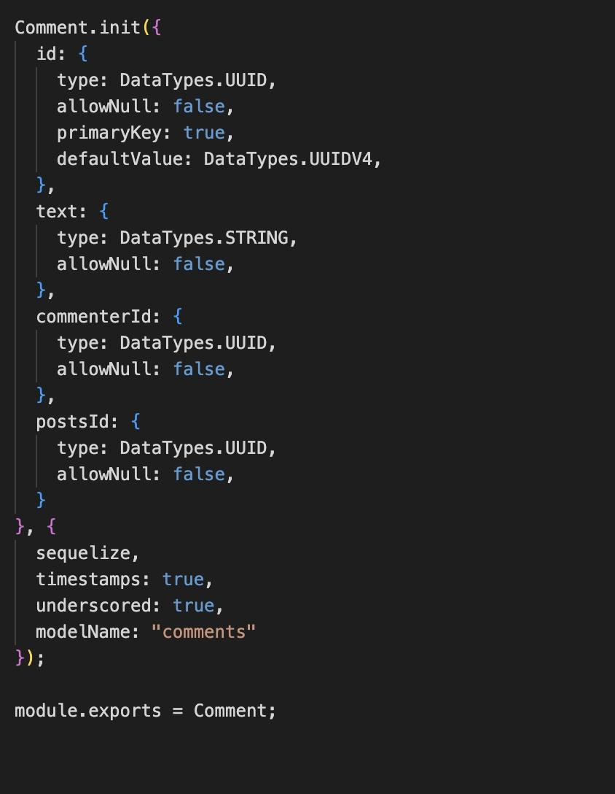
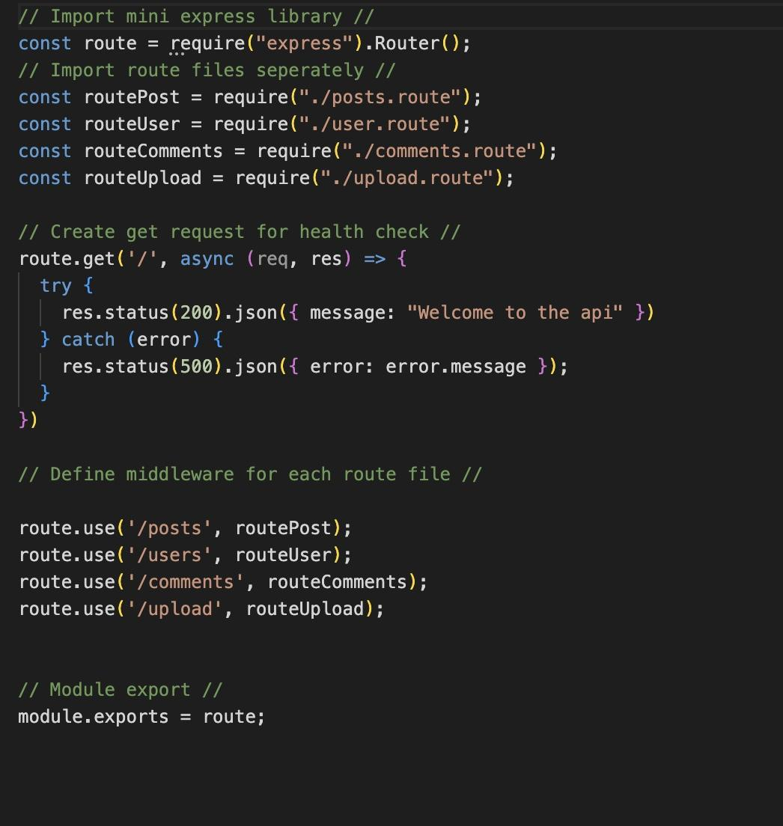
FEATURES ADDED
ENV
AUTHENTICATION
MODELS
ROUTES
SERVER

Slide 9
CHALLENGES & ACHIEVEMENTS
CHALLENGES
Debugging issues
ACHIEVEMENTS
Delivered all core backend features

Slide 10
BEATRICE EMAKPOSE
Role: Frontend Developer
Technologies used:
  - React (components, props, context)
- CSS (Flexbox with flex-wrap)
- JSON (mock data for posts + comments)
- Figma (UI design reference)

Slide 11
Features Added
Built a posts preview feed that displays all posts in a responsive, reusable layout
Created a Postcard component showing avatar, name, image, likes and comments
Added mock data (Captions + comments) to stimulates real user interactions
Integrated feed into the Home page using usePosts context

Slide 12
Challenges
Mapping Figma design into reusable components
Ensuring posts render correctly whether passed as a single post or array.
Case sensitivity errors in Vite (e.g. file/components)
Handling fall back logic for missing avatars

Slide 13
Achievements
Delivered a pixel-aligned, responsive feed using flex-wrap.
Created scalable and reusable components (PostsPreviewFeed + PostCard)
Improved data realism with captions + comments JSON
Strengthened UI consistency across pages.

Slide 14
CHARLES RICHER
Role: Frontend Developer
Technologies Used:
  React / JSX
  HTML & CSS
  JavaScript
Features added:
  Forms - Login, Registration, Add New Post, Add Comment
  Modals - View Post
  Styling - Core Styles, Class Consolidation, Responsive Design

Slide 15
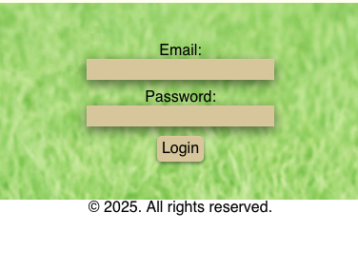
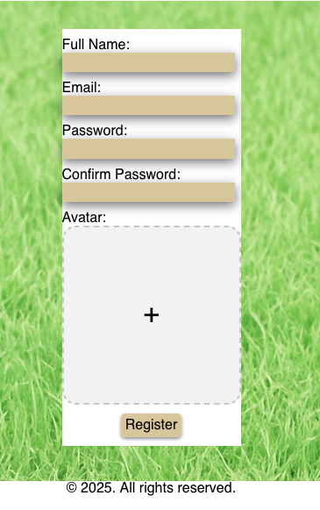
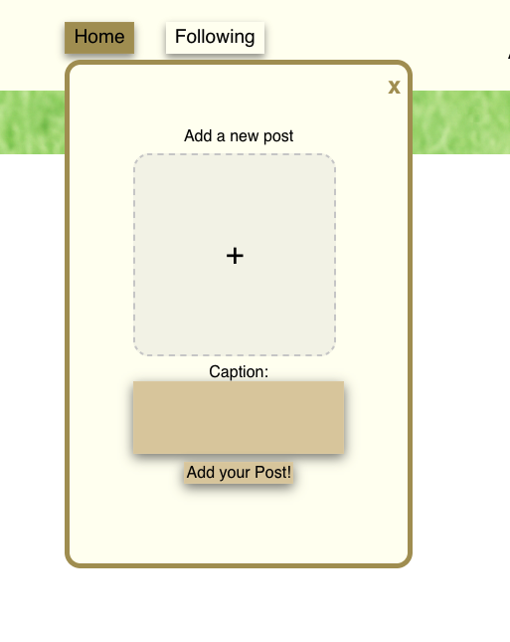
Frontend Development
Registration Form
Add New Post Form
Login Form

Slide 16
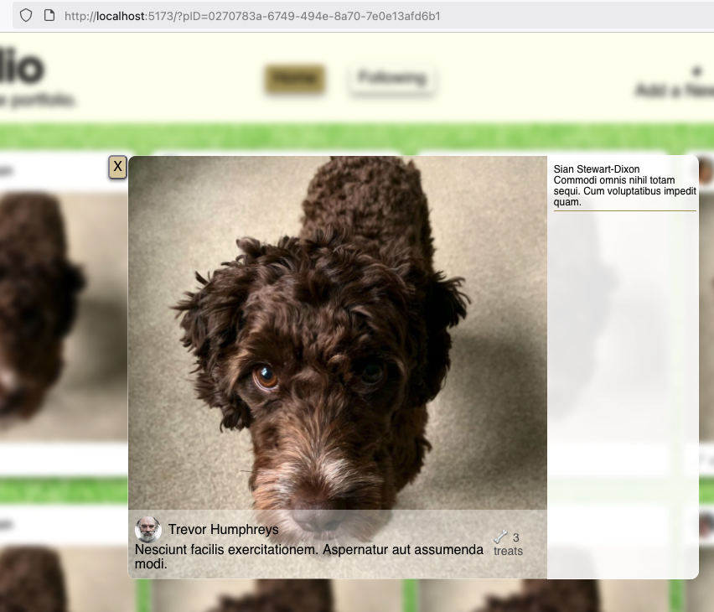
Post Viewer Modal

Slide 17
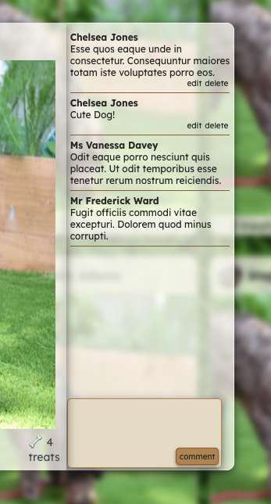
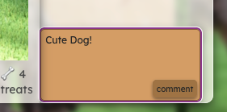
Add Comment

Slide 18
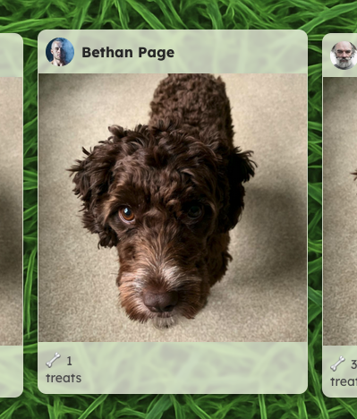
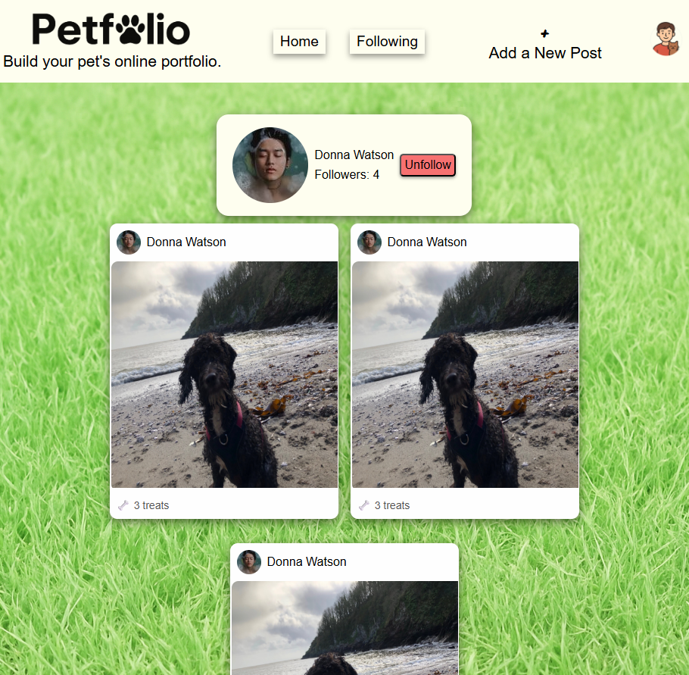
STYLING CHANGES

Slide 19
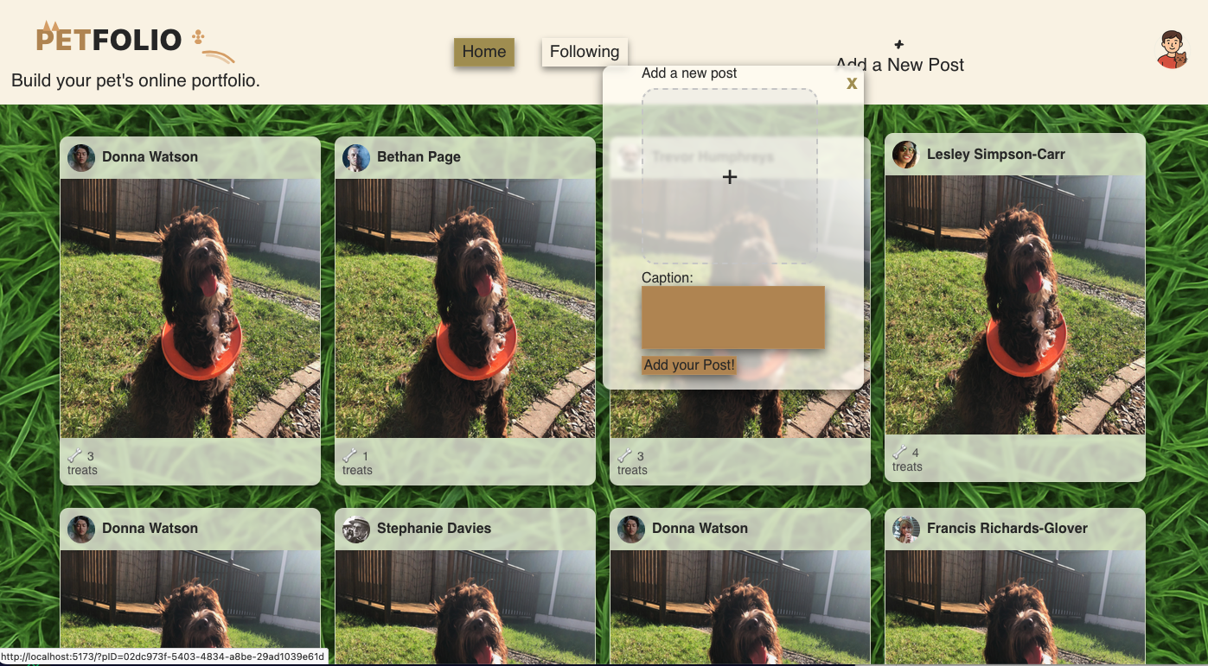
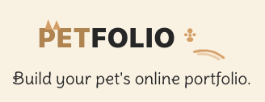
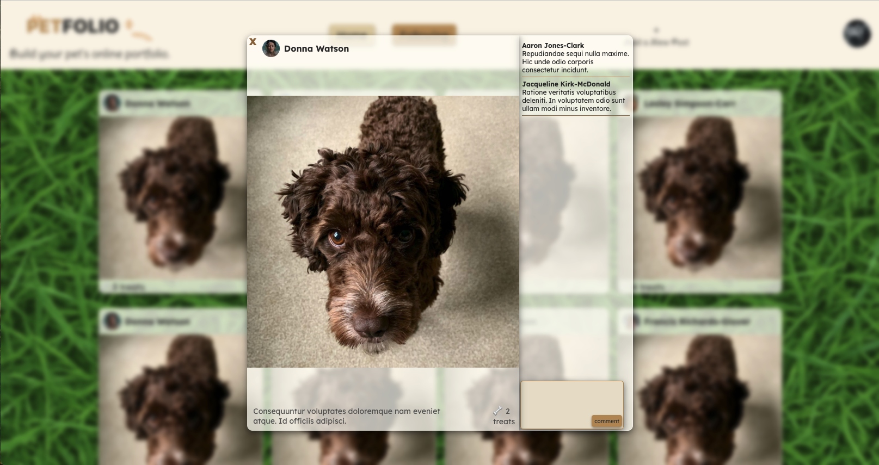
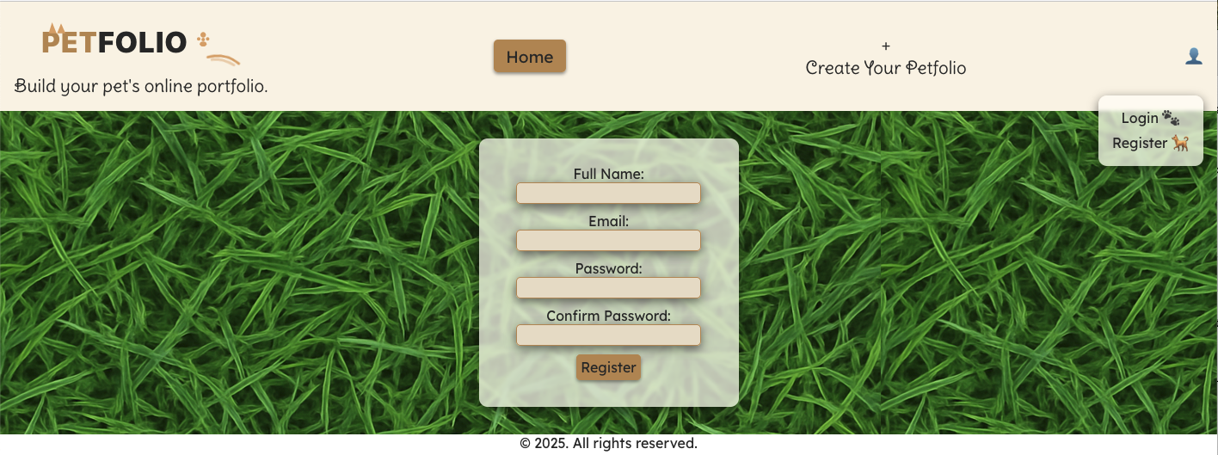

Slide 20
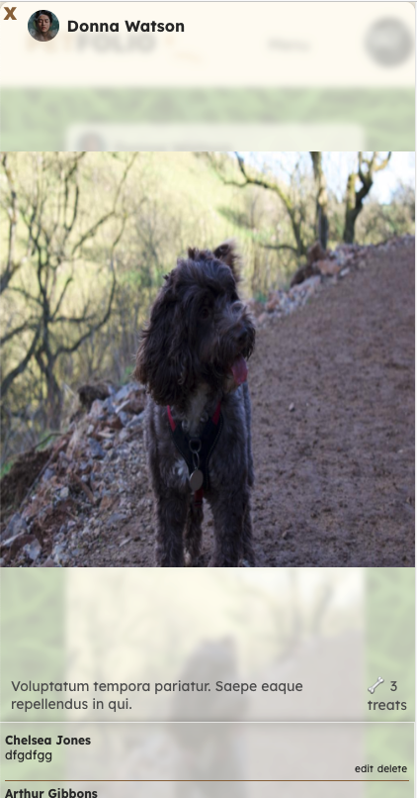
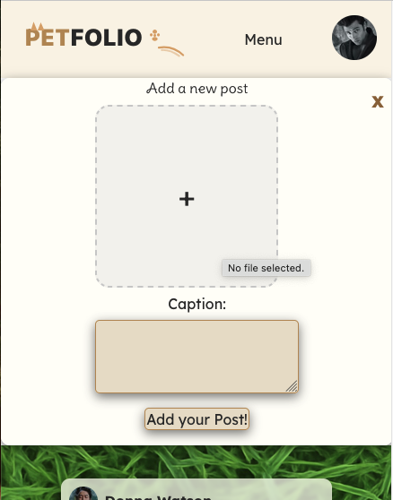
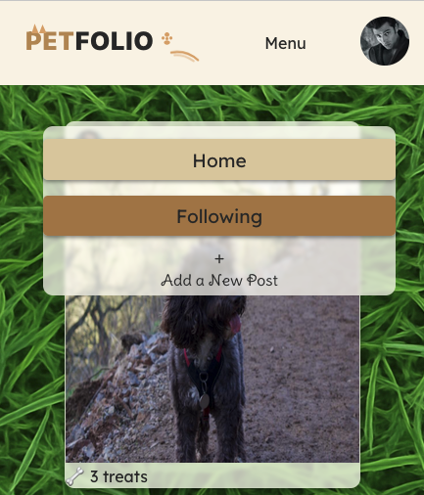
Responsive Design

Slide 21
DEMONSTRATION

Slide 22
FUTURE DEVELOPMENTS
Features:
Pet profiles – multiple pets per user, follow pets individually.
Search and filters – find pets by name, breed, or location.
Recommended/trending pets - show popular pets by overall and personal data.
Hashtags – easier sharing and discovery.
Data:
Pagination & GraphQL – scalable performance for larger datasets.
Loading icons & error states – clear user feedback during fetches.
User Safety:
Reporting & moderation tools – administrator dashboard for reviewing reports, restricting access or banning users.
Monetisation:
Pet adoption listings – partner with shelters to rehome pets.
Sponsored posts – partner with pet brands, charities, vets, etc.
Marketplace – buy and sell pet-related products.

Slide 23
Q&A

Slide 24
THANK YOU

